Slide 1

Hacking with mickey
By: Sushil Phuyal

Slide 2
Why are we here?
Understanding CIA
Basic networking and protocol
What is hacking and its illusions
Roadmap to become a hacker
Basic cyber threats in our day-to-day life.
Basic attacks live
Security tools used by infosec
Why Linux?
Red team
Black hat hacking methodologies / teen attraction

Slide 3
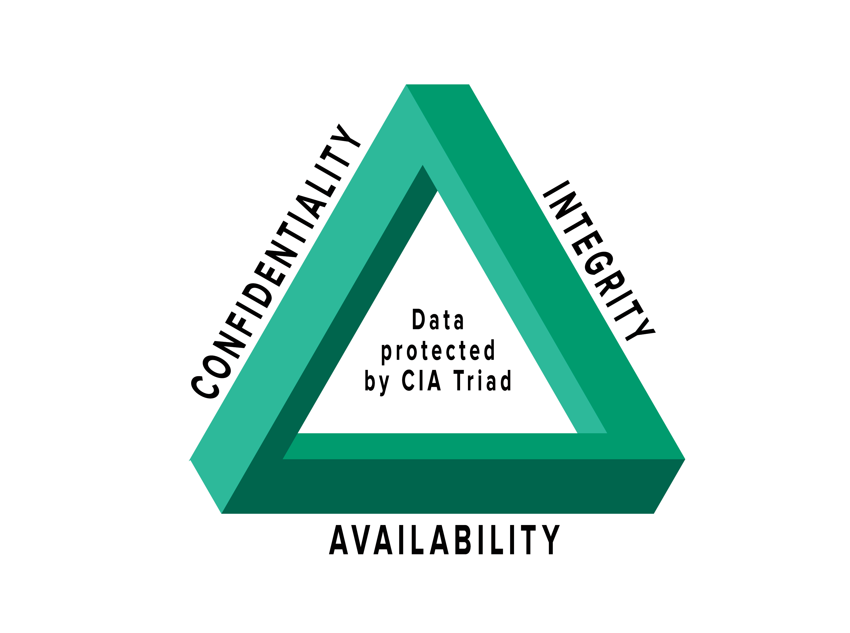
What is CIA?
Confidentiality
Integrity
Availability

Slide 4
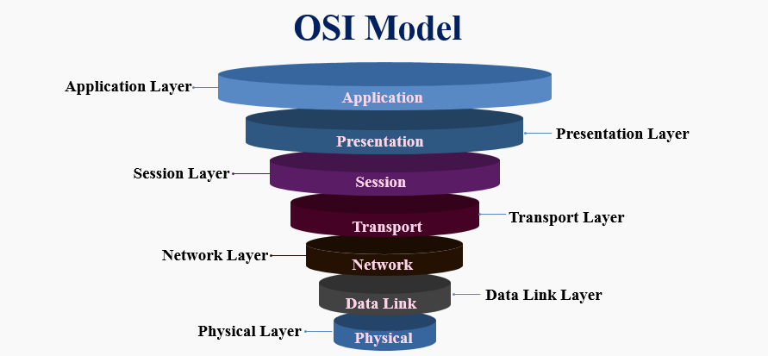
OSI layer
“Please Do Not Tell Secret Passwords Anytime”

Slide 5

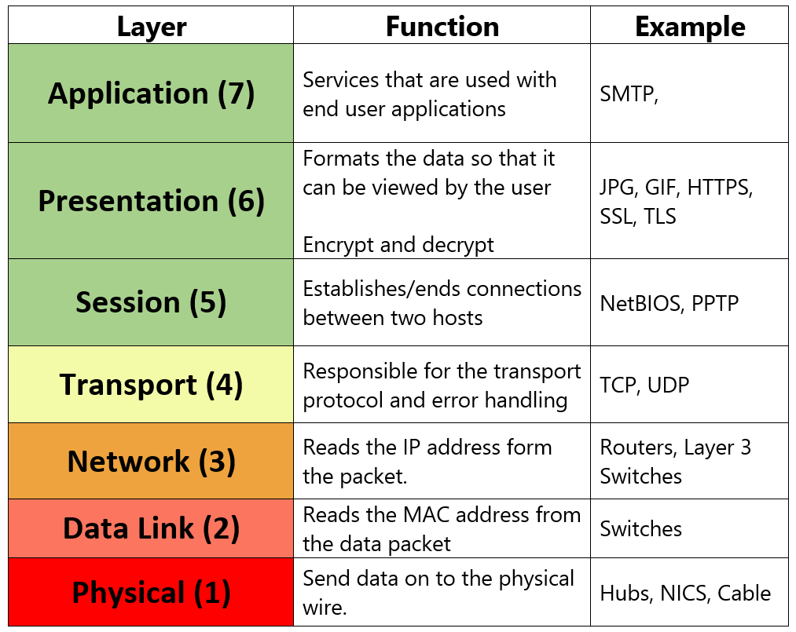
Diving deeper into OSI

Slide 6

What is hacking?
Unauthorized access to network or system
Exploiting miss configuration, security controls or vulnerable services.
It has more illusions than facts
“If something looks like spell in today’s world, then it’s exploit.”

Slide 7
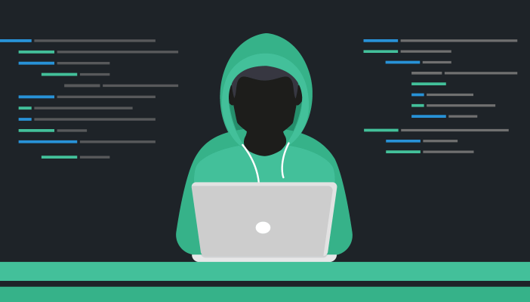
How do I become a hacker?
Understand how it works and eventually break into it.

Slide 8
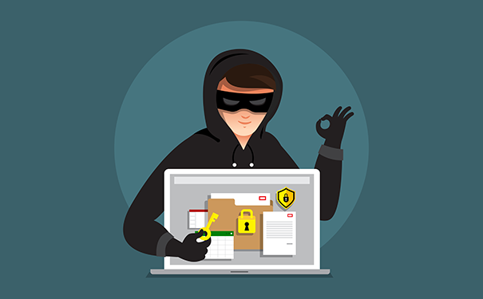
How do I become a hacker?
We can also use resource like, portswiggers, tryhackme or hackthebox as a beginner to start hacking.

Slide 9
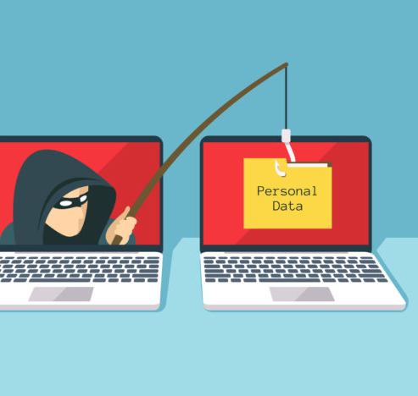
Basic cyber attacks that we see everyday.
Phishing and vishing.
DNS/ARP attacks.
Mail spoofing.
Password protection.
Social media threats.
Torrenting and ransomware.

Slide 10
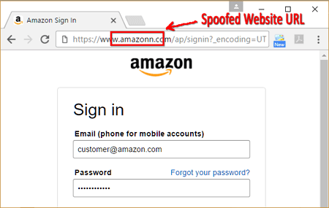
Phishing and Vishing

Slide 11
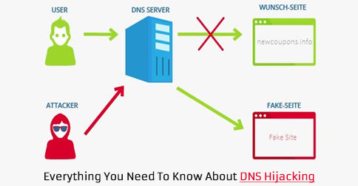
DNS and ARP spoofing

Slide 12
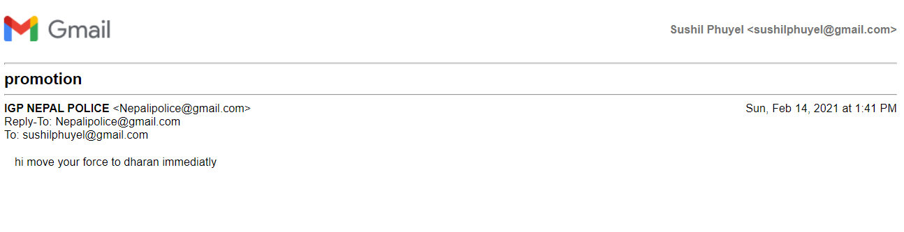
Mail spoofing

Slide 13

Password protection

Slide 14

Social media threats
Scam
Blackmailing
Sexting
Harassments
Ransome
Identity theft

Slide 15
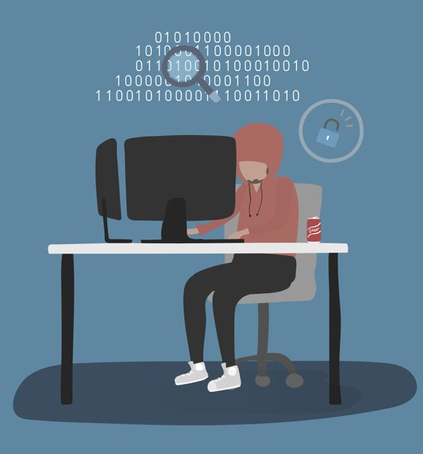
Torrenting and ransomeware
Ransomware
Malware
RAT

Slide 16

Let’s hack live
Exploiting SQL injection and XSS.
“with ethics”

Slide 17

Security tools used by infosec
Burp suite
Nmap
Metasploit
Rengine
John the ripper
Maltego
Wireshark

Slide 18

Why Linux?
Open source
Good terminal environment
Supreme control of privilege
Perfect control through CLI
“Around 70% web servers uses Linux server”

Slide 19

Red team
We are cyber defenders too.

Slide 20
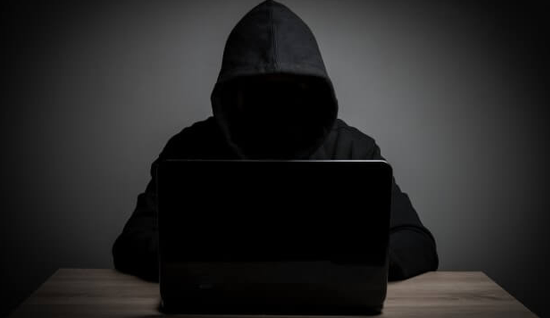
Black hat hacking and teen attraction
It’s not about others, its about you.

Slide 21

BE SECURED,
The next Target could be you

Slide 22
Thank you! Happy hacking

